Slide 1





cOLUMBIA ASIA HOSPITAL
Roopam Srivastava
14/3/2024

Slide 2

Agenda
Introduction
Methods & approach
FIndings
Summary
References

Slide 3

Introduction
Columbia Asia is an international private healthcare company with an extensive network of hospitals. The Columbia Asia Hospital started its operations in the year 1996. Currently it has 22 medical facilities across Southeast Asia: 14 in Malaysia, 3 in Vietnam and 5 in Indonesia.
Columbia Asia medical facilities provide a wide array of medical services such as General Surgery, Pediatrics, Obstetrics & Gynecology, Orthopedics and Internal Medicine. These are supported by a comprehensive list of ancillary services that include an Intensive Care Unit, Neonatal Care Unit, Physiotherapy, Laboratory, Pharmacy and Imaging.
The company believes in setting up mid-size hospitals built in residential areas for accessibility and efficiency, and to better serve the respective communities.
Columbia Asia aims to be the preferred choice of healthcare services for families and businesses.

Slide 4

kpis

Slide 5
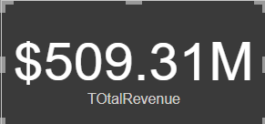
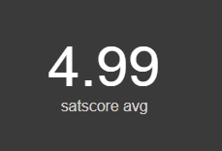
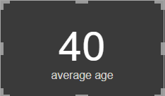
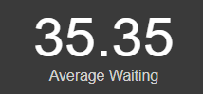
Findings of analysis
The total revenue earned by the hospital is about $509.31M.
The average satisfaction score of the patient is around 4.99.
The average age of the patient is around 40 years
The average waiting_time of the patient is around 35.35 mins

Slide 6
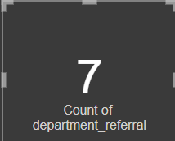
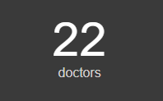
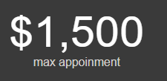
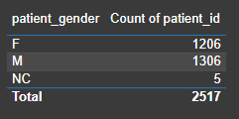
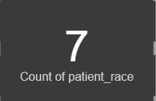
Findings of analysis
There are total 7 department in the hospital.
There are total 22 doctors in the hospital.
The maximum appointment fees of hospital is $1,500.
There are 1306 male and 1206 female patient in hospital.
The patients visiting hospital belongs to 7 different races.

Slide 7
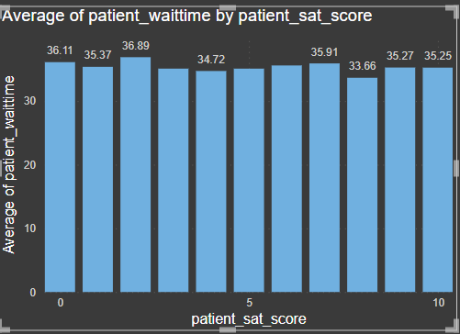
Findings of analysis
We can say that the average patient wait time is inversely proportional to satisfaction score, in many cases its seen that the less average time wait has high satisfaction score as compared to the patient whose wait time is higher. It can be seen that low wait time has a score of 8-10 while high wait time has score rate of 0-3.

Slide 8
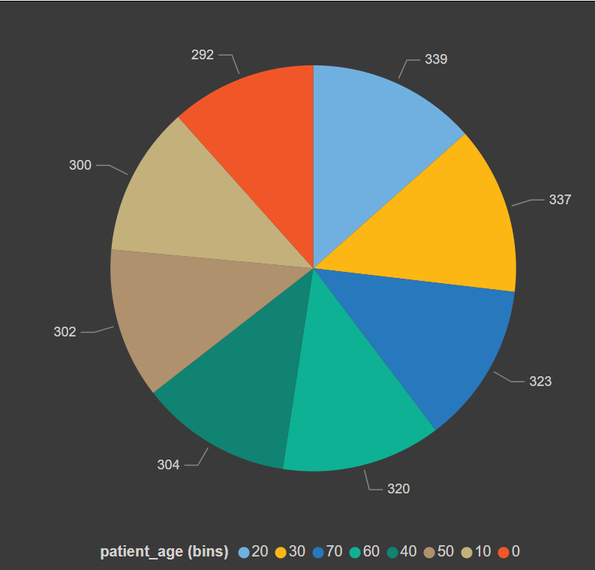
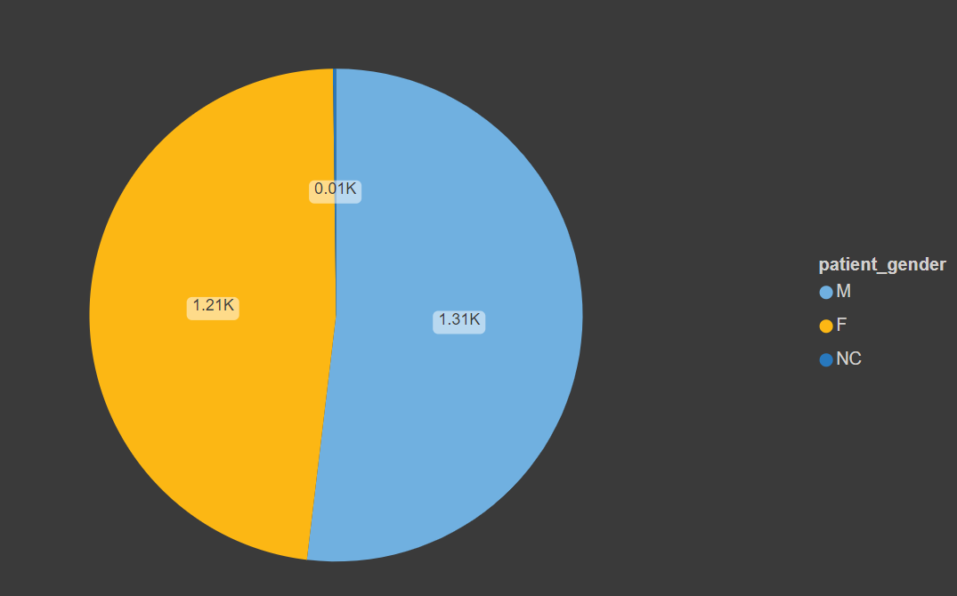
Findings of analysis
From the given data set it can be that the majority of the patient coming to the hospital are male that is around 1306 while only 1206 females visit the hospital. On the basis of the ages of patients the maximum number of patients that visits the hospital belongs to the age group of 20 (20-30) followed by the people of age group 30 (30-40). While the lowest number of patients belong to age group of 0 (0-10).

Slide 9
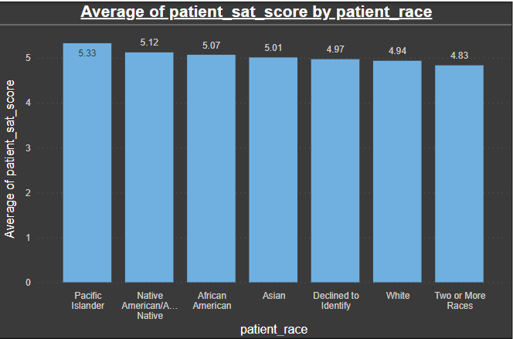
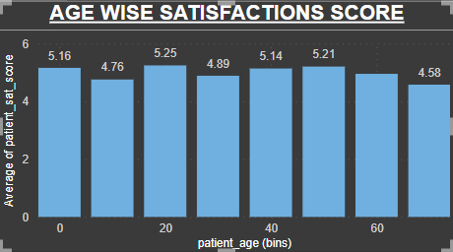
Findings of analysis
From the above graph shown it can be seen that the according to the age group there is declining trend in the satisfaction score of patients which can increased by giving prioritization to senior citizens in place of youths, which would help in increasing the patient’s satisfaction score. While in racial group it can be seen that the Pacific Islanders have highest satisfaction score that is 5.33. While the two or more races race have the least satisfaction score that is 4.83.

Slide 10
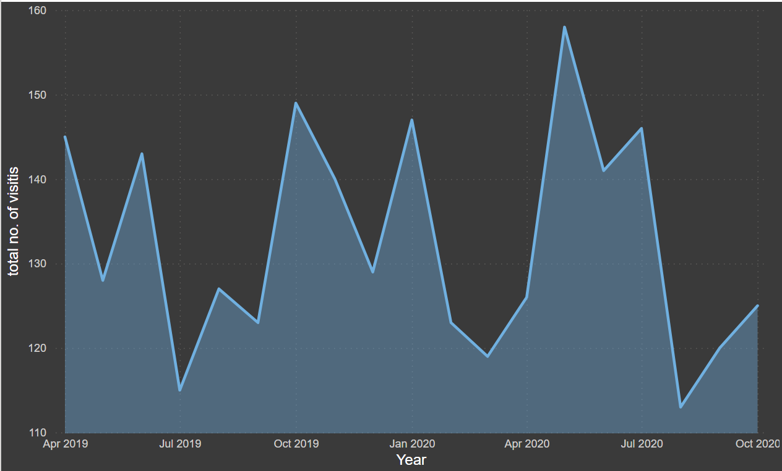
Findings of analysis
From the above graph it can be seen there is a decline in the number of visits from April 2019 to May 2019 which suddenly shoots up in June 2019 which later declined in July 2019. But as seen overall trend of number of visits to month it can be seen that there is fluctuation in every month. The highest number of visits can be seen in the month of May 2020 which is 158 patients which is followed by October 2019 which is 149. While the month of August 2020 shows the minimum patients.

Slide 11
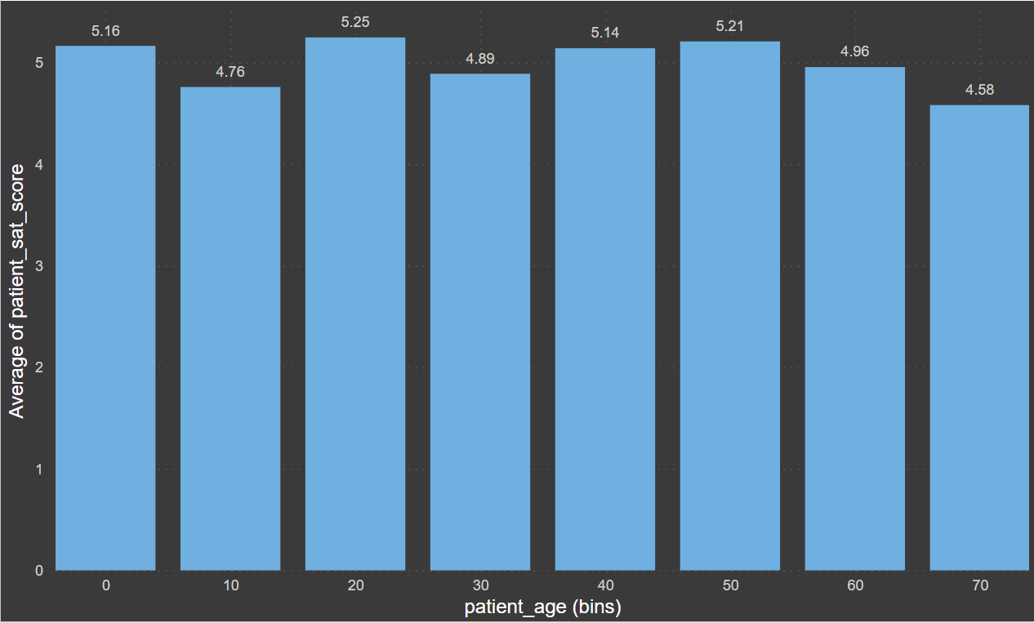
Findings of analysis
The age group of 20 (20-30) shows the highest satisfaction score i.e. 5.25 which is followed by age group of 50 (50-60) i.e. 5.21. While the age group of 70 (70-90) shows the lowest satisfaction score i.e. 4.58. (used average satisfaction score vs age group)

Slide 12
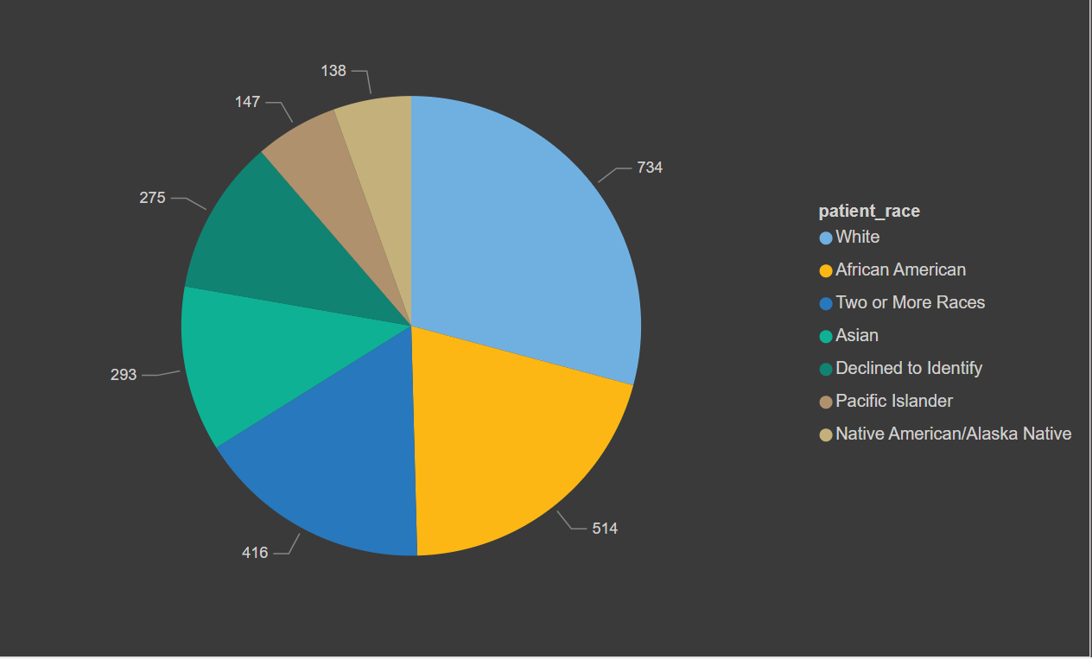
Findings of analysis
So, if someone outside of the hospital claims that there is racial or gender-based discrimination in the hospital, it can be said that the above claim was not true as it can be that second majority of the patient in the hospital visited are African American, not only that but more than 5 racial community comes here for the treatment. Not only by racial but along with that the female patients are in good number which is only 100 less than that of male patients. So the hospital is non-biased in terms of race and gender of patients.

Slide 13
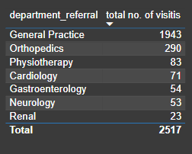
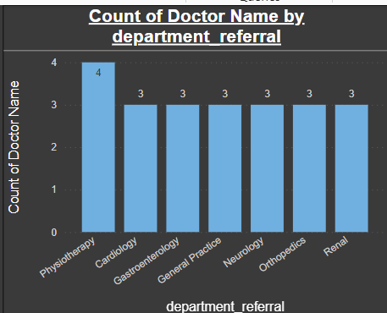
Findings of analysis
If the hospital has a budget to hire 2-3 new doctors, they should be hired in the Orthopedics, General Practice and Physiotherapy, as they have highest numbers of visitors and a smaller number of doctors. Thus, it will help in increasing the revenue as these departments are busier as compared to others.

Slide 14
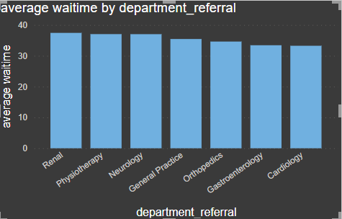
Findings of analysis
The average waiting time of the renal department is oddly large as compared to other departments which is around 37.43 minutes. Which is followed by Physiotherapy department which is 37.04 minutes. While the cardiology has the least waiting time that is 33.25 minutes.

Slide 15
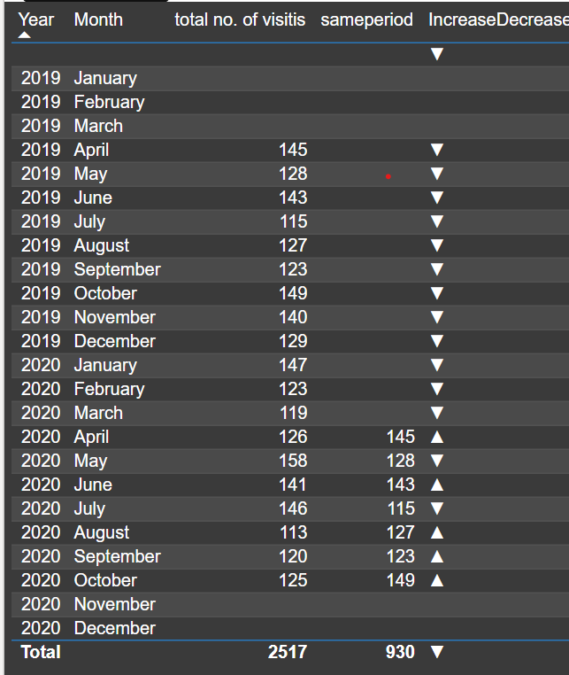
TREND OF PATIENTS VISIT
From the given table on the side there can be seen some trends in the patients visit from 2019 to 2020.
In this it can be seen that the month of April, June, August, September and October shows the increasing trend of patients visit as compared to the previous year visits from 2019.
While the month of May and July of year 2020 shows the declining trend of patients visit as compared to same time in the year 2019.

Slide 16
Findings of analysis
If as compared to the appointment fees taken by the doctors to the total revenue earned by hospital, it can be said that the hospital is profitable. As the total fees by the doctor is 5.35M. thus by excluding that from the total revenue determines the profitability.
There is a one-to-one relationship between the doctor id and department, as each doctor is assigned to single department. Like one doctor is associated to single department. There is no single doctor who are assigned to multiple departments.
The hospital management should offer discounts to the patients of the age group of 60 (60-70) & 70 (70-80). As they are seniors and need more assistance as compared to the youth generations, thus it will help in increasing the satisfaction score of patients and there can be increase in the patients of this age group also
The strategies we could use to provide discounts to the patients should be like giving 50% discount in the appointment fees of doctor to all the seniors category of 60 (60-70) & 70 (70-80). And we can also provide extra free facilities to the senior citizens like massage area or free regular tests. Thus, it will not increase the number of patients but also increase the satisfaction score of patients by attracting new patients.

Slide 17
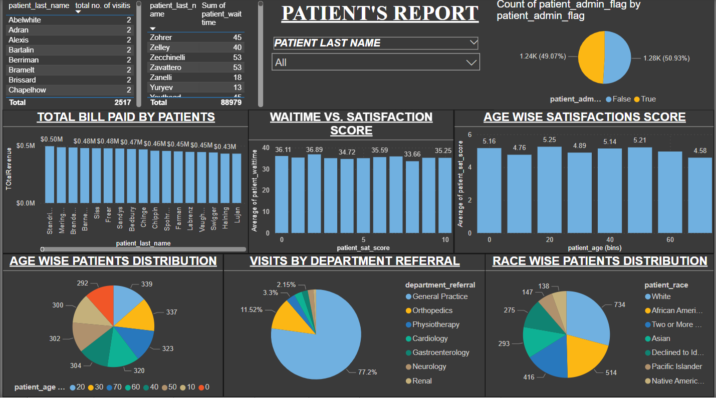
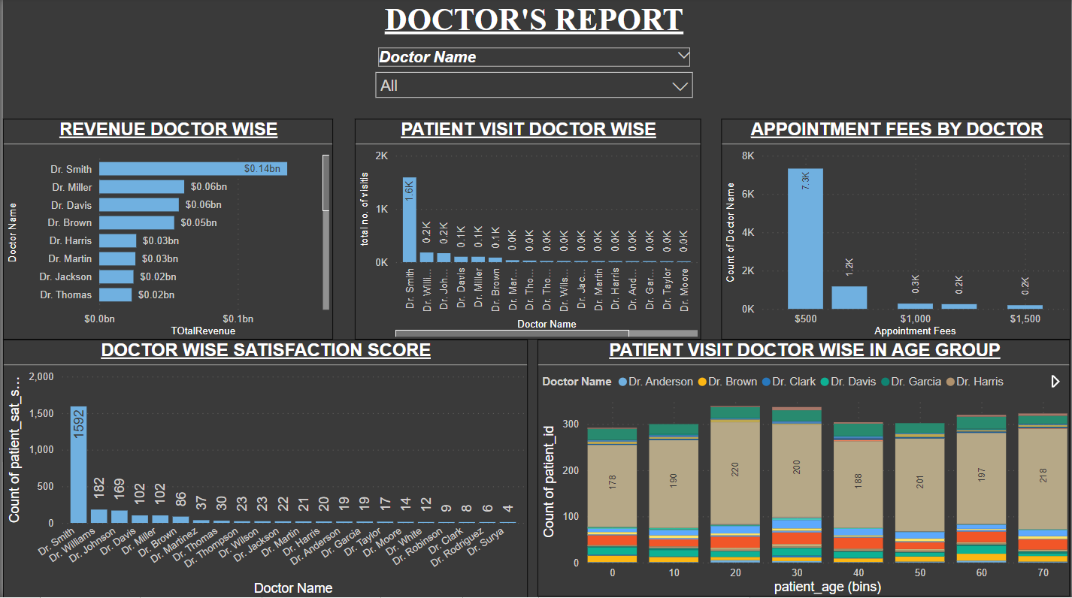
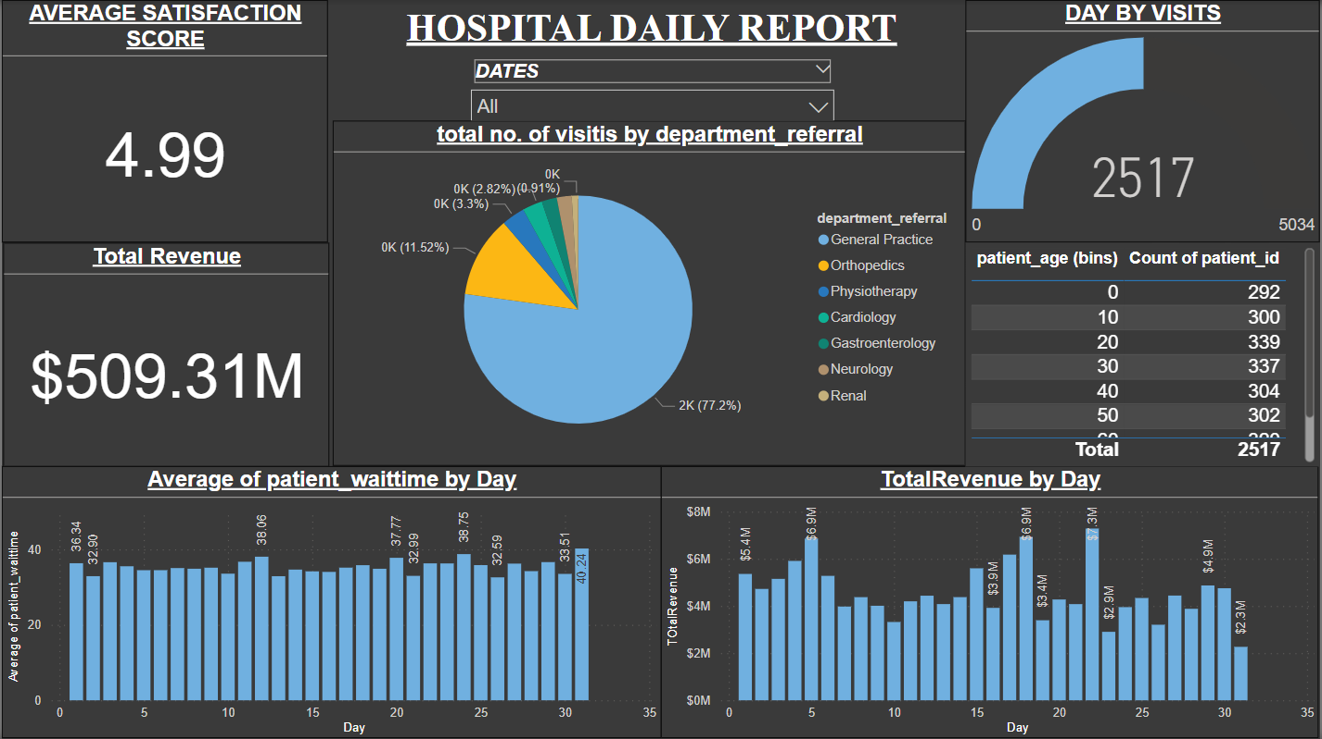
reports

Slide 18




How we got there
Dax functions
The calculations shown in the ppt are done by creating new measures using different DAX functions like CALCULATE, AVERAGE, MAX, SUMX,etc.
Visualizations
The findings which were made according to the data provided has been visualized in the report using different charts and tables like line, pie, donut, column, bar, etc

Slide 19

reference
https://medium.com/@arjunuttamsharma561/m-query-language-in-power-bi-db1916ee2b1a#:~:text=M%20Query%20is%20a%20%E2%80%9Cmashup,using%20M%20in%20the%20background.
https://learn.microsoft.com/en-us/dax/max-function-dax
https://senturus.com/blog/power-bi-gateway-explained/#:~:text=The%20Power%20BI%20gateway%20supports,both%20uptime%20and%20performance%20reasons

Slide 20


Thank you
rOOPAM Srivastava
14/3/2024

